Slide 1

Creating a CV/Résumé for Grad School
Sara Castro
Graduate Studies Resource Center (GSRC)

Slide 2
Résumé vs CV – What’s the difference?
Résumé | CV
Audience: Any employer or HR manager | Audience: Academic committees
Outlines professional and educational experiences most relevant to position | Presents who you are as a scholar, emphasizing research/academic accomplishments relevant to your academic path
Selected publications and academic presentations are optional | Includes full list of publications, academic presentations, and professional affiliations
Objective statement may appear at the top of a resume | Objective statement not needed
1-2 pages in length | No maximum length
Notes:
https://www.accuconference.com/blog/types-of-presentations/

Slide 3
A Curriculum Vitae (CV) can be used for:
Graduate admission
Sending to professors/employers for letters of recommendations
Academic employment
Academic internships
Conferences
Scholarships & fellowships

Slide 4
When choosing how to organize your document, consider the following:
Type of program (research-focused vs. professional program)
Special instructions from the specific program (e.g., page limit, specific organization, additional information to include)
Include only what is necessary to show that you have the qualifications and skills to achieve your current goal—getting the job or into the graduate program

Slide 5
Formatting & Style
Standard, simple formatting
Standard font (e.g., Times New Roman, Arial, Garamond)
10-12-point font
Clutter can make your document difficult to read and navigate. Blank spaces are attractive and improve ease of reading
Clarity, consistency, and uniformity are key
Notes:
https://www.accuconference.com/blog/types-of-presentations/

Slide 6
What can I include in my CV?
Heading – name and contact information (professional email address)
Education
Honors and study abroad experience
Relevant coursework (most relevant for career changers; do not list all coursework)
Research experience
Research interests
Laboratory skills and instrumentation experience
Publications
Conference presentations
Notes:
https://www.accuconference.com/blog/types-of-presentations/

Slide 7
What can I include in my CV?
Conference presentations
Teaching experience
Professional experience (includes paid internships)
Volunteer experience (includes unpaid internships)
Relevant Certifications/Licenses
Skills (technical and specific to your field)
Recognitions, fellowships, scholarships, travel grants
Campus involvement
Professional memberships or affiliations
Notes:
https://www.accuconference.com/blog/types-of-presentations/

Slide 8
Note:
Organization and order vary by discipline (e.g., a social worker would prioritize clinical and internship experiences vs. laboratory experiences)
What you include will depend on what you wish to emphasize and prioritize.
  A CV for a higher education PhD program will be different than a CV for a clinical psychology PhD program.
  A CV for a laboratory internship will be different than a CV for a teaching position at a community college.

Slide 9
Header – what should be included?
Name (include middle initial)
Mailing address
Email address (student/professional email)
Telephone number
Optional - LinkedIn address

Slide 10
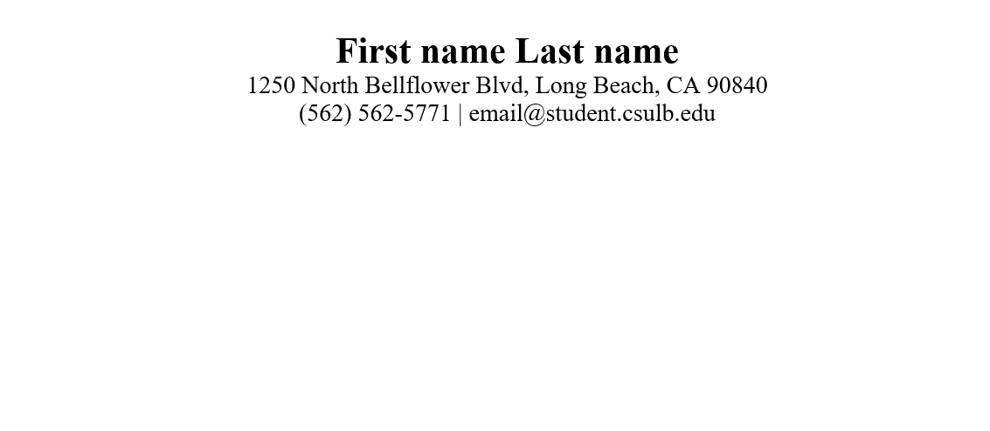

Slide 11
      Education
Name of university
Official name of degree(s)
Graduation date
Optional: Study Abroad, High GPA, or thesis title
List degrees in reverse chronological order (most recent degree is listed first)
Optional: Relevant coursework
Include if there are a few courses you want to emphasize (e.g., advanced research methods or statistics, a specific computer science course); note that the admissions committee will have access to transcripts

Slide 12
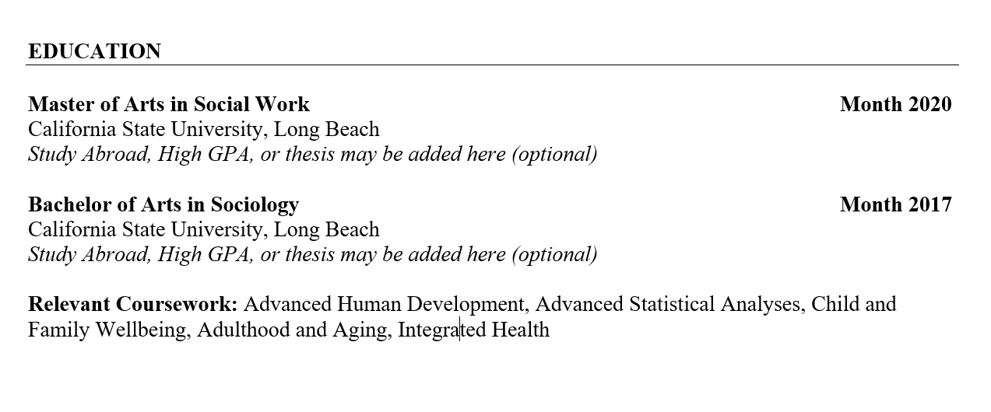

Slide 13
    Research/Professional Interests
    Research interests/Professional interests
    Include if you want to highlight special interests. This is an efficient way to convey to admissions committees that you are interested in a particular topic, population, setting, and so on (e.g., “African American Literature in the 20th Century)
    Publications
    Professional presentations
    Note: for publications, use a consistent formatting style (APA, MLA, Chicago)

Slide 14
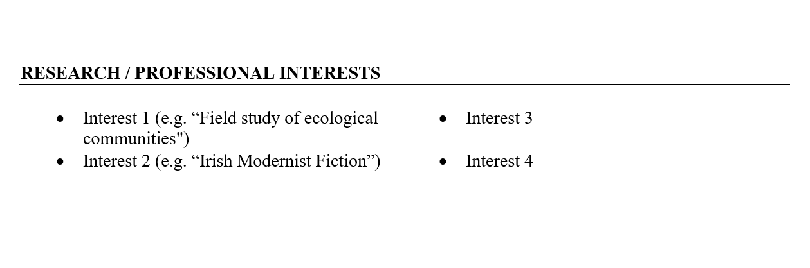

Slide 15
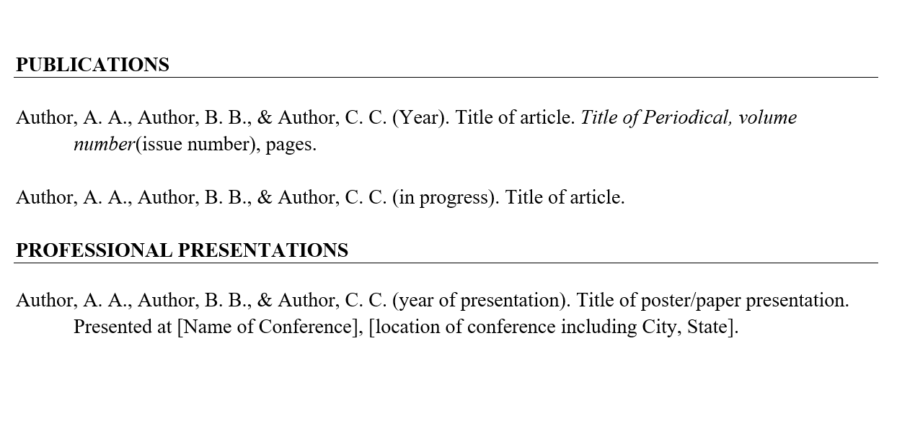

Slide 16
Professional Experience
    List in reverse chronological order (most recent first)
    If applying to a research-focused degree, “Research Experience” can appear before professional experience
    Include full-time and part-time jobs. It is strongly preferred that these are relevant to your
    field of study. You can also include relevant internships (paid) and self-employment

Slide 17
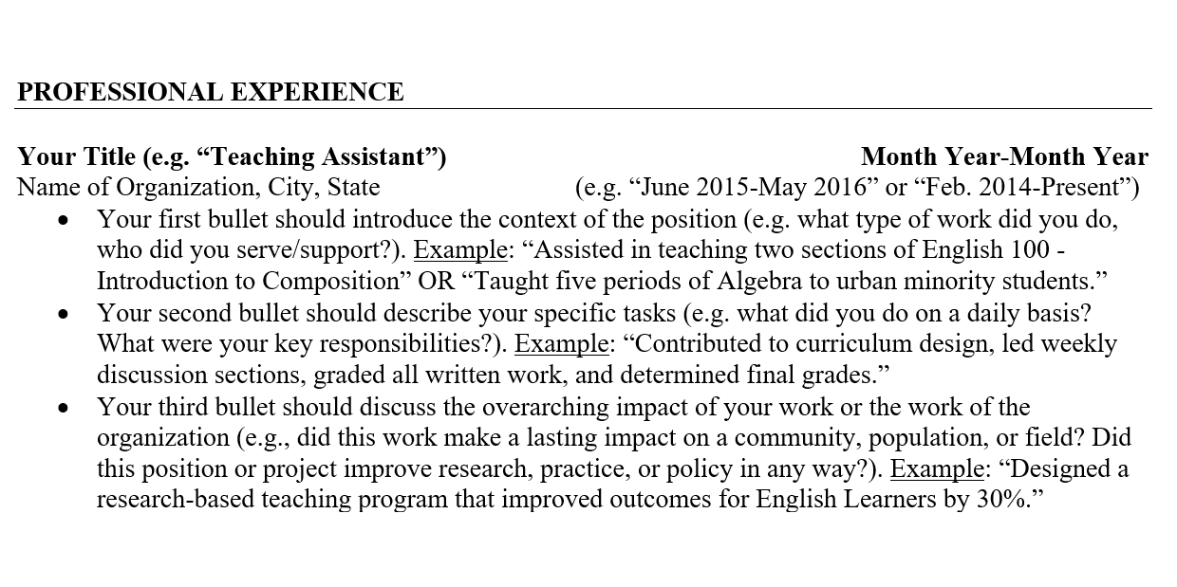

Slide 18
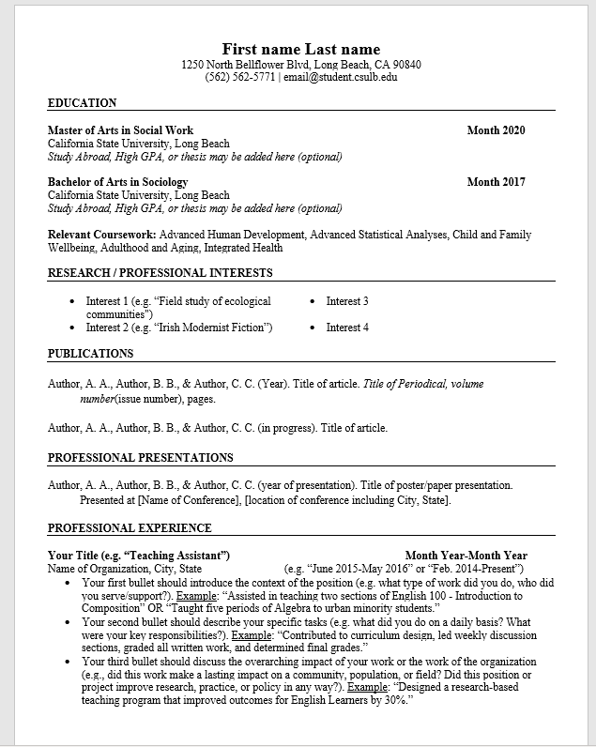

Slide 19
    Teaching experience (in higher education)
      Title (e.g., teaching assistant, co-instructor, instructor)
      Semester & year
      Course number & title
      Department or college name
      University name

Slide 20
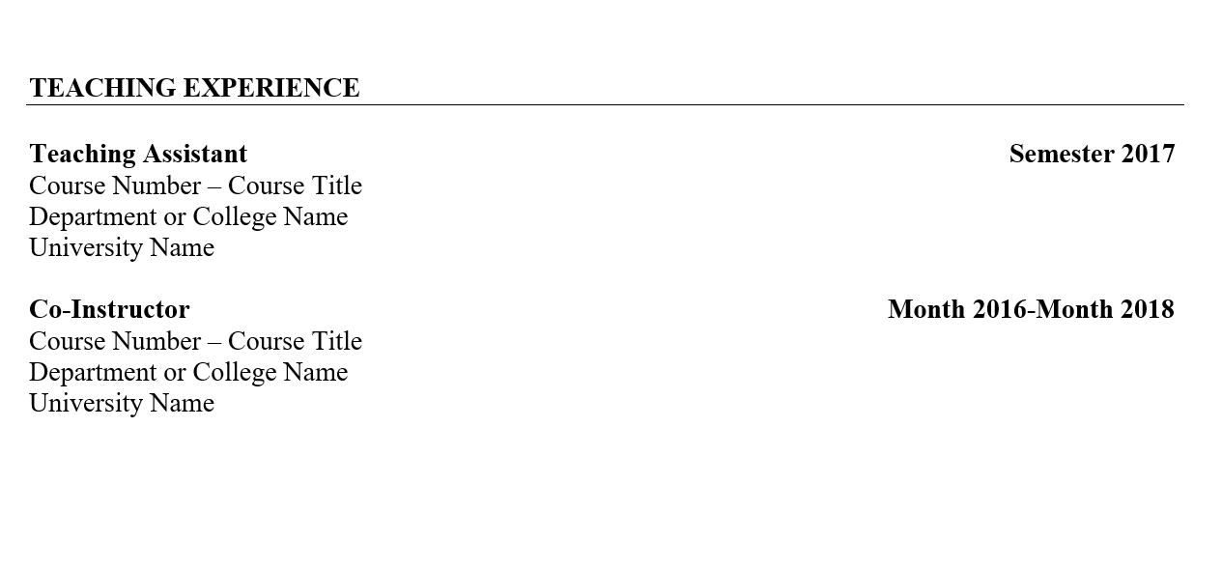

Slide 21
Volunteer Experience
Particularly important for applicants with limited professional experience and for graduate school applications in human service fields (e.g. counseling, social work)
Include relevant/related experiences
Presentation format is similar to that of professional experience/employment section

Slide 22
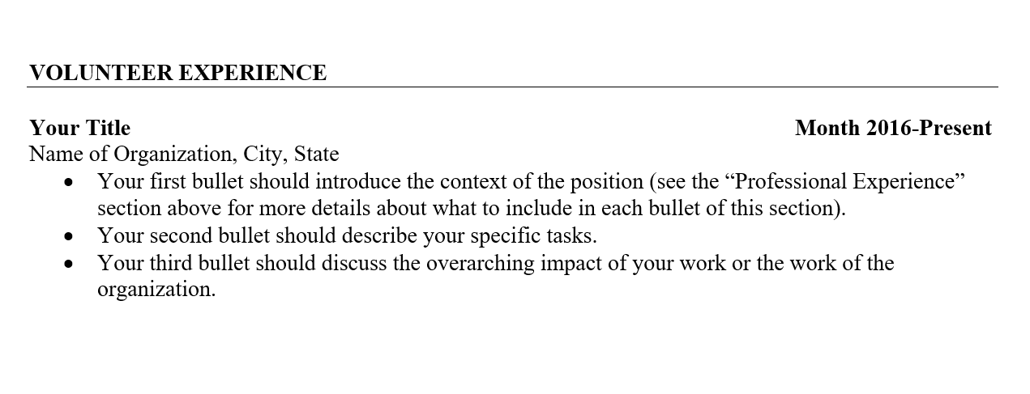

Slide 23
Other items to include in the CV
Skills and Abilities
  Should be technical and quantifiable. Avoid including “soft skills” such as “Good with people.” Anyone can write these skills, and these should be evident in your professional skills above (i.e., “show” don’t “tell”)
  Skills to include: computer software, languages other than English, laboratory skills, knowledge of discipline specific models/strategies
Honors and Awards
  Include scholarships, fellowships, travel grants, recognitions, President’s or Dean’s List, awards through competitions, and so on

Slide 24
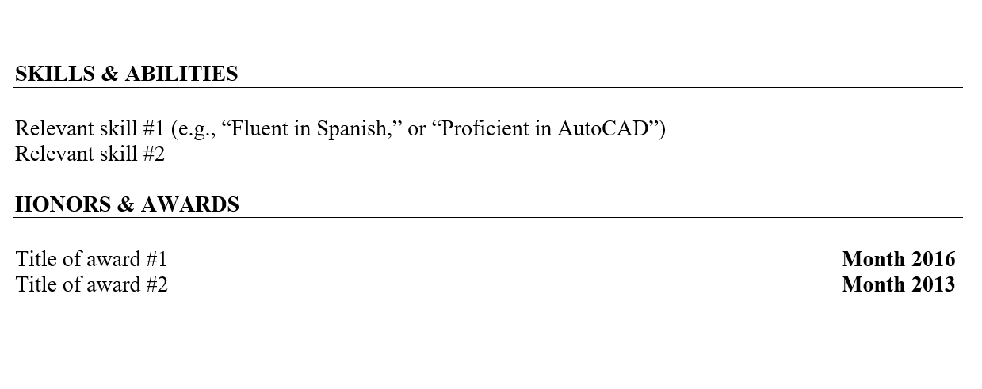

Slide 25
Other items to include in the CV
Campus Involvement (Campus organizations/chapters, leadership roles)
Certifications (e.g., CPR/First Aid for fields in healthcare)
Professional Affiliations Indicator of your interest in the field
  Many national organizations offer student memberships at a reduced fee. Memberships in these organizations can show interest in your specific field (e.g., American Psychological Association, Linguistic Society of America)

Slide 26
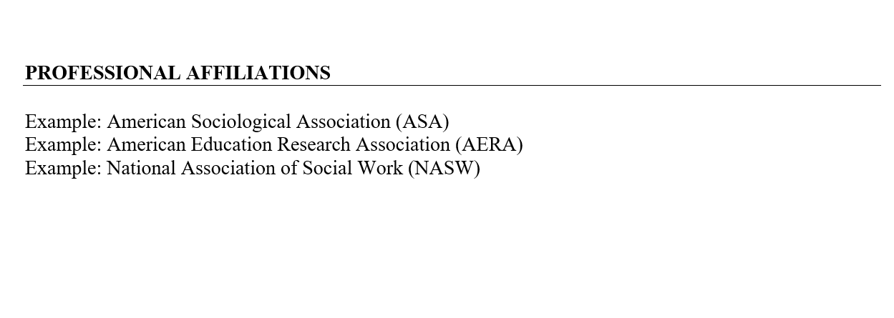

Slide 27
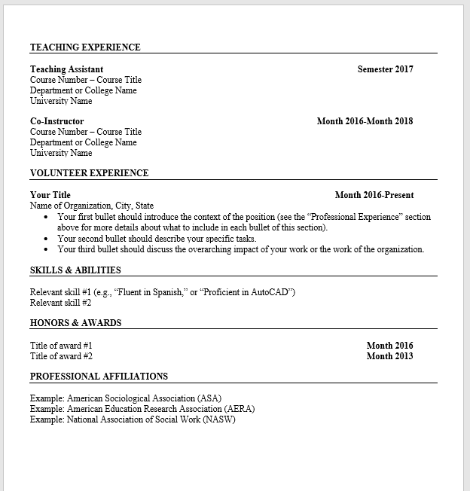

Slide 28
Additional Tips and Advice
There is no one “right way” to write a CV. It is a living document that takes multiple revisions to finalize and should be tailored to each specific program, job, and so on
Look at real-life examples of CVs to get ideas on how to organize and format your own. University websites almost always include faculty CVs that you can review
Ask professors and mentors in your major for advice on the specific conventions and expectations of CVs in your discipline/field of study

Slide 29
And finally…
A polished, well-developed document can show a lot about you:
attention to detail
organization skills
professionalism
written communication
computer skills
Remember to proofread before sending or submitting! ☺

Slide 30
  Where can I receive help with my CV?
  → Answer: 3 places at CSULB
  Career Development Center
  University Writing Center
  Graduate Studies Resource Center

Slide 31
Contact
GSRC@csulb.edu

