Slide 1
Arguments
Omar Hussein
Graduate Writing specialist
The CSULB graduate Center

Slide 2
Preliminaries
“Once you’ve accumulated a stack of notes, photocopies, and summaries, don’t keep piling them up until they spill off your desk (or you lose track of them on your hard drive). It’s time to impose some order on what you’ve found. The risk, however, is that you just group your data under obvious headings, arrange them into some arbitrary sequence, and start writing. Do that and you’re likely to end up with a data dump that says little more than ‘Here are some facts about my topic.’ You need a more powerful principle of organization, one based not on your data but on the solution to your problem and the logic of its support. That support takes the form of a research argument.”
—Booth, Colomb, &Williams (2008), The Craft of Research, 3rd ed.
The following slides borrow and steal shamelessly from The Craft of Research and other related works by Joseph Williams and company. I note the sources (as I’m doing here) but I don’t always use proper citation.

Slide 3
Preliminaries (continued)
Arguments are meant to convince readers. They answer the question “Why should I believe that?”
Experienced writers may plan the argument and the paper draft at the same time.
Beginners, or anyone struggling with arguments, might need to first plan the argument, then plan (and draft) the paper.

Slide 4
Arguments: Thinking about the reader
For any piece of writing, you should always be thinking about the reader.
  Who is the reader?
  What does the reader want to know? (i.e., why is the reader reading my paper)
Don’t think of the reader as your professor (even if your professor is the only person who’s actually going to read the paper). Thinking this way is a mistake.
Instead, picture an idealized or imaginary reader. For college and grad school, a good imaginary reader might be a classmate of yours (a peer) who shares with you a knowledge of the basic ideas of the field but doesn’t know anything about your specific paper topic.

Slide 5
Arguments: Thinking about the reader (continued)
Another (related) way of thinking about the imaginary reader (from the philosopher Jim Pryor):
  “Pretend that your reader is lazy, stupid, and mean. He's lazy in that he doesn't want to figure out what your convoluted sentences are supposed to mean, and he doesn't want to figure out what your argument is, if it's not already obvious. He's stupid, so you have to explain everything you say to him in simple, bite-sized pieces. And he's mean, so he's not going to read your paper charitably. (For example, if something you say admits of more than one interpretation, he's going to assume you meant the less plausible thing.)"
  Source (Pryor’s page is on philosophical writing, but that quote is relevant to academic writing in general).

Slide 6
Planning your argument: Questions to ask yourself
What am I claiming?
What reason(s) do I have for believing my claim(s)?
What evidence supports those reasons?
Do I acknowledge and respond to possible objections?
What principle (warrant) makes my reason(s) and evidence relevant to my claim(s)?

Slide 7
Claims + Reasons
Claims are based on reasons
The emancipation of Russian peasants was an empty gesture (claim) because it did not improve the material quality of their daily lives. (reason)
TV violence can have harmful psychological effects on children (claim) because their constant exposure to violent images makes them think that violence is natural. (reason)
These reasons, in turn, are supported by evidence.

Slide 8
Claims + Reasons: Practice
Which one of these sentences is the (main) claim of the paragraph?
Manufacturers increase profits and sales when they create loyal customers who buy their product once and return to buy it a second time without the need for advertising or a high-powered sales force. Customers become loyal when they are satisfied with the quality of service they get on the product when it breaks down, but more importantly with the product’s intrinsic quality. Therefore, while manufacturers should focus on both service and product quality, they should emphasize product quality.
Source: Wiliams and Colomb (2003), The Craft of Argument (2nd ed.).

Slide 9
Claims + Reasons: Practice - answer
Which one of these sentences is the (main) claim of the paragraph?
Manufacturers increase profits and sales when they create loyal customers who buy their product once and return to buy it a second time without the need for advertising or a high-powered sales force. Customers become loyal when they are satisfied with the quality of service they get on the product when it breaks down, but more importantly with the product’s intrinsic quality. Therefore, while manufacturers should focus on both service and product quality, they should emphasize product quality.

Slide 10
Core of an argument
CLAIM based on REASONS supported by EVIDENCE
Humans are causing global warming (CLAIM) because human activities like energy production and transportation are pumping large quantities of excess CO₂ into the atmosphere (REASON), and numerous studies (Anderson et al., 2016; Callendar, 1938; Kramer et al., 2021) demonstrate that excess CO2 traps energy from the sun that would normally be reflected into space, thus warming the planet (EVIDENCE).
Arguments sometimes also (1) acknowledge and respond to counterarguments and (2) provide a general principle (warrant) that shows how the reasons and evidence are relevant to the claim.

Slide 11
Clarification of terms
Claim: A sentence that asserts something that can be true or false. The answer to your research question is a type of claim, and so is the solution to a problem.
Main claim of a paper (also called a “thesis statement”): The sentence (or sentences) that the whole paper supports.
Reason: A sentence supporting a claim, main or not.
These terms can be confusing, because a reason is also a sub-claim that can be supported by more reasons.
  For example: TV can have harmful psychological effects on children (main claim) because when they are constantly exposed to violent images, they come to think violence is natural. (sub-claim = reason 1 supporting main claim) Those exposed to lots of such visual entertainment tend to adopt the values of what they see. (sub-claim = reason 2 supporting reason 1)
In other words, reasons support main claims, but “lower” reasons can support “higher” reasons.

Slide 12
Example
TV violence can have harmful psychological effects on children (claim) because those exposed to lots of TV tend to adopt the values of what they see. (reason 1 supporting the claim). Constant exposure to violent images makes them unable to distinguish fantasy from reality. (reason 2 supporting, or elaborating on, reason 1). Smith (1997) found that children ages 5–7 who watched more than three hours of violent television a day were 25 percent more likely to say that what they saw on television was “really happening.” (evidence supporting reason 2).
But we can also think of reasons as being sub-claims. →

Slide 13
Example (alternate analysis)
TV violence can have harmful psychological effects on children (claim) because those exposed to lots of TV tend to adopt the values of what they see. (reason 1 supporting the claim = sub-claim 1). Constant exposure to violent images makes them unable to distinguish fantasy from reality. (reason 2 supporting reason 1 = sub-claim 2). Smith (1997) found that children ages 5–7 who watched more than three hours of violent television a day were 25 percent more likely to say that what they saw on television was “really happening.” (evidence supporting reason 2).

Slide 14
Evidence vs. reasons
Evidence is usually considered to be based on the senses, even if indirectly (e.g., facts discovered by observation or experiment), but can also (depending on the field) include logical and mathematical reasoning. Examples of evidence: Case studies, statistics, confirmed facts, expert testimony.
In grad school, your evidence will usually be: (1) citations of reputable sources or (2) your own data that you collected, or (3) (in some cases) your own deduction, proofs, or reasoning.
We usually have to search for evidence in the world. In contrast, we think up reasons in our own mind.
Contrast:
  What evidence do you base your reason on? (sounds perfectly natural/answerable)
  What reason do you base your evidence on? (sounds weird/unanswerable)

Slide 15
Acknowledging & responding to objections (counter-arguments)
Remember, your imaginary reader is “mean”:
  “No thoughtful reader will accept your claim based solely on your views: you must also address theirs.” –Craft of Argument, p. 112
You have to practice figuring out different ways that a reader might object to your argument, then acknowledge and respond to these objections.

Slide 16
Example with acknowledgement + response
TV violence can have harmful psychological effects on children (claim) because those exposed to lots of TV tend to adopt the values of what they see. (reason 1 supporting the claim = sub-claim 1). Constant exposure to violent images makes them unable to distinguish fantasy from reality. (reason 2 supporting reason 1 = sub-claim 2). Smith (1997) found that children ages 5–7 who watched more than three hours of violent television a day were 25 percent more likely to say that what they saw on television was “really happening.” (evidence supporting reason 2). Of course, some children who watch more violent entertainment might already be attracted to violence. (acknowledgment) But Jones (1999) found that children with no predisposition to violence were as attracted to violent images as those with a violent history. (response)

Slide 17
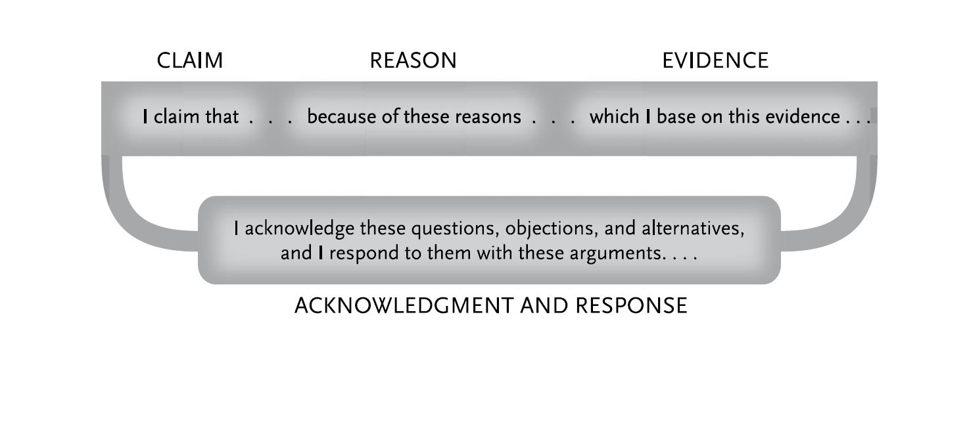
Figure 1:
From The Craft of Research (3rd ed.), p. 113

Slide 18
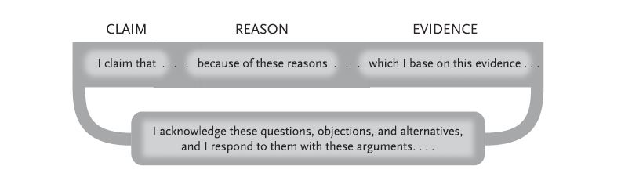
But Don’t follow figure 1 too rigidly
Claims, reasons, etc. can occur in many different orders. Sometimes you start with the acknowledgement (“While it is commonly argued that…”), followed by your response(s) (“This claim is suspect for several reasons….”) and finally your claim. (“For these reasons, I argue that…”).
You can also sometimes start with evidence (“Each year, 5 million people experience bullying on social media sites…. In addition, 30% of internet users…. ”), followed by the reasons (sub-claims) that this evidence supports (“These numbers show that internet bullying is a major problem…”), and then finally your main claim (“Thus, mental health experts must study internet bullying…”).
You also might need to add explanations or elaborations (e.g., defining terms, giving concrete examples) along the way to help your reader.

Slide 19
Do you have a Warrant?
Even when readers agree that a reason is true, they may not see why that reason is relevant to you claim.
  For example: We should leave (claim) because 2 + 2 = 4 (reason). Presumably everyone will agree that the reason is true. But what does it have to do with the claim?
Here’s a less wacky example:
  We are facing significantly higher health care costs in Europe and
  North America (claim) because global warming is moving the line of
  extended hard freezes steadily northward. (reason)
Again, the connection between claim and reason isn’t obvious. What do hard freezes have to do with healthcare costs?

Slide 20
Warrants (continued)
This argument—
  We are facing significantly higher health care costs in Europe and North America (claim) because global warming is moving the line of extended hard freezes steadily northward. (reason)
—needs a warrant: a general principle that shows how the reason supports the claim. Here’s one:
  When an area has fewer hard freezes, it must pay more to combat new diseases carried by subtropical insects no longer killed by those freezes.

Slide 21
Warrants (continued)
Here’s the argument with the warrant added:
  When an area has fewer hard freezes, it can expect higher medical costs to cope with diseases carried by subtropical insects that do not survive freezes. (warrant) Europe and North America must thus expect higher health care costs (main claim) because global warming is moving the line of extended hard freezes steadily north. (reason) In the last one hundred years, the line of hard freezes lasting more than two weeks has moved north at the rate of roughly… (evidence)

Slide 22
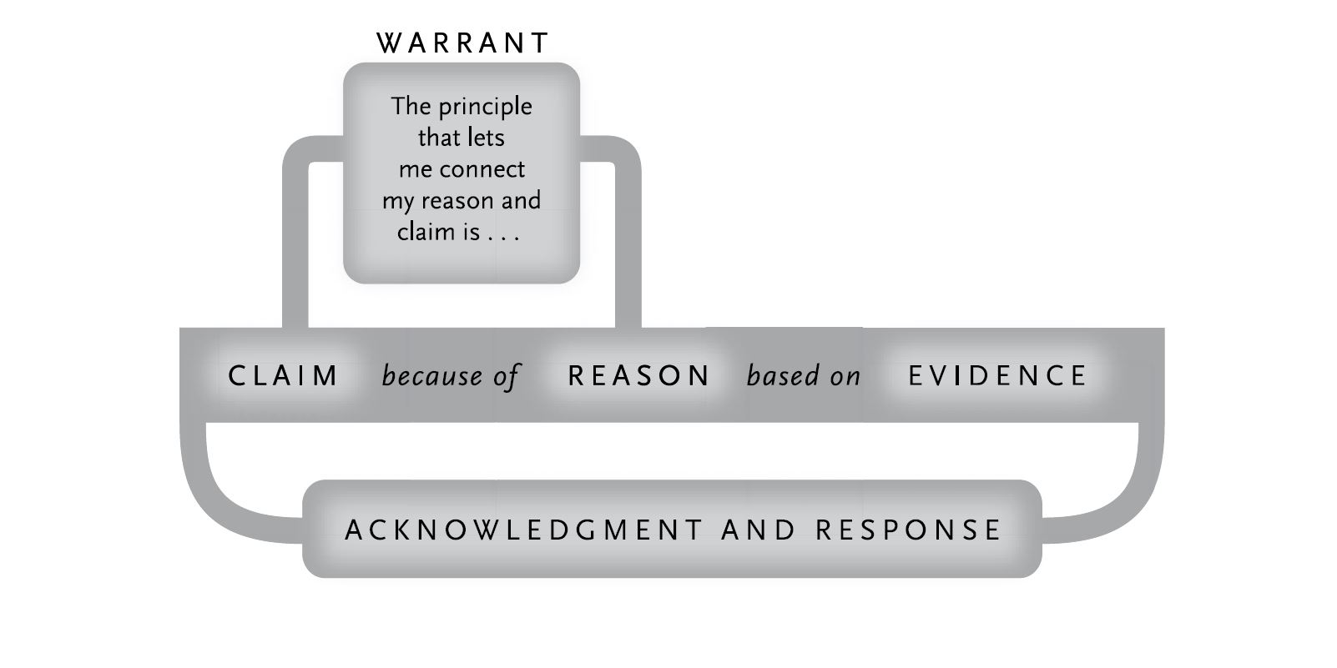
Figure 2:
From The Craft of Research (3rd ed.), p. 116

Slide 23
Building a complex argument
The 5 elements (claim, evidence, reason, acknowledgement + response, warrant) constitute the core of a “basic” argument. But arguments in research reports are usually more complex.
We almost always support a claim with two or more reasons, each of which must be supported by its own evidence and perhaps justified by its own warrant.
Since readers think of many alternatives and objections to any complex argument, you’ll typically have to respond to several of them.
Note: The text on this slide and two following it is “plagiarized” almost verbatim from The Craft of Research, pp. 116-117.

Slide 24
Building a complex argument (continued)
Moreover, each element of an argument may itself have to be treated as a subclaim, supported by its own argument.
Each response to an objection may need reasons and evidence to support it.
If your readers doubt the truth of a warrant, you may have to treat it as a subclaim and support it with its own argument, including reasons, evidence, and perhaps even its own warrant with its own acknowledgments and responses.
Only the evidence “stands alone,” but even then you must explain where you got it and maybe why you think it’s reliable, and that may require yet another argument.

Slide 25
Building a complex argument (continued)
Finally, you might need to do elaboration.
Most arguments include background, definitions, explanations of issues that readers might not understand, and so on.
If, for example, you were making an argument about the relationship between inflation and money supply to readers not familiar with economic theory, you would have to explain how economists define “money.”
Serious arguments are complex constructions.

