Slide 1

Resume (and CV)

Slide 2
C.R.A.P. stands for…
Contrast
Repetition
Alignment
Proximity

Slide 3
C.R.A.P. is for the reader - 1
As Larry McEnerney says:
“No advice about writing makes any sense unless you’ve clarified (1) who’s reading it and (2) the function of the text.”

Slide 4
C.R.A.P. is for the reader - 2
1. Who’s reading it?
Potential employers.
The admissions committee.
Scholarship/fellowship committee.
2. The function of the text
To get you an interview.
(for some grad applications) To help you get admitted.

Slide 5
Your goals
Be as clear, simple, and direct as possible.
Convey only the things (skills and experiences) that are relevant.
Put the most important/most relevant stuff first.
Make sure everything is easy for the reader to find/see.
Don’t make the reader do unnecessary work.

Slide 6
Your goals - 2
In short:
Make the reader happy
As Jim Pryor says, “pretend that your reader is lazy, stupid, and mean.” (Source.)

Slide 7
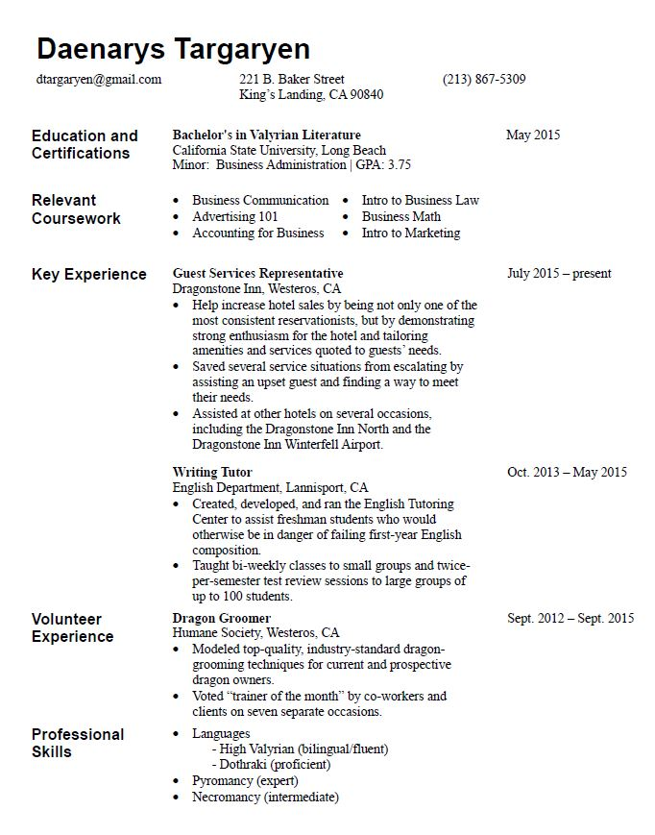
Good example

Slide 8
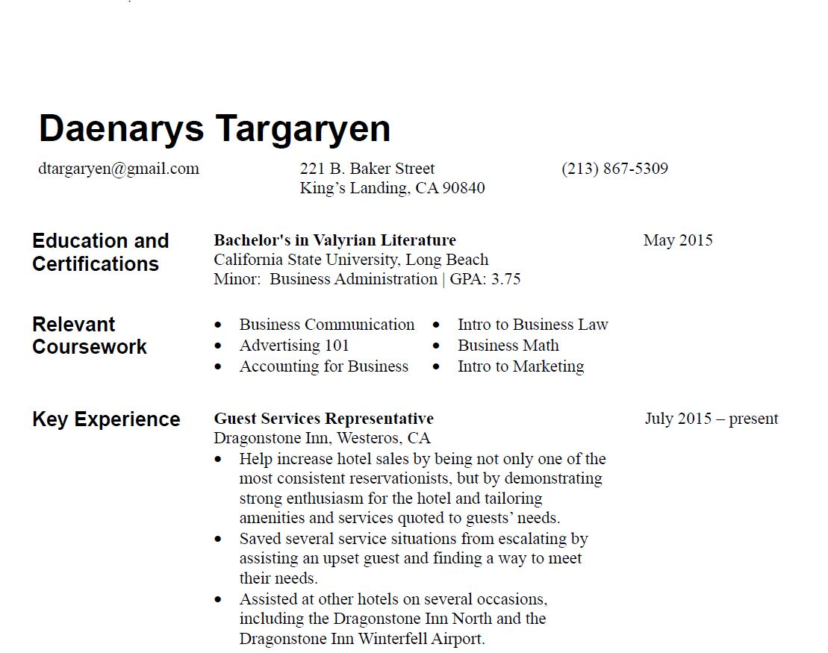
Contrast
Serif fonts for headers but sans serif fonts for body text
Headers are bold but body text is regular
Headers are larger than body text
Titles of jobs and degrees are bold

Slide 9
Repetition
Use the same structure for each section (e.g., Title on top, location underneath).
Don’t make the reader do extra work trying to figure out how each section (e.g., Education, Experience) is organized.
Stay consistent.

Slide 10
Alignment
Create columns for the reader to “scan” downward (e.g., all the dates are lined up on one column).
Columns should be left-aligned.
In MS Word, you can use tables to do this.

Slide 11
Proximity
Keep headers close to the body text that goes with them.
Use whitespace to separate sections with different headers. Whitespace is good, because crowded documents tire the eyes.
You can create this effect in MS Word using tables.

