Slide 1
Writing the statement of purpose
Omar Hussein
Graduate Writing Specialist
The Graduate Center

Slide 2
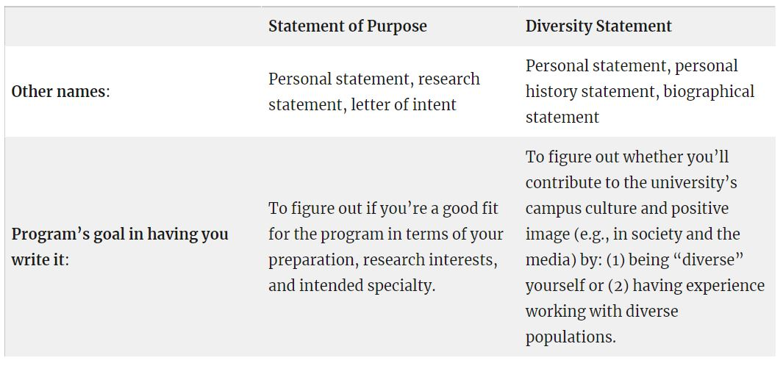
Statements of Purpose vs. Personal Statements vs Diversity Statements

Slide 3
First, let’s talk about audience
For any text you write, ask yourself 2 questions:
Who’s reading it?
Why are they reading it?
Source: The “Chicago School” – Larry McEnerney, Joseph Williams, Gregory Colomb, Wayne Booth and others.

Slide 4
Answers
Who’s reading it? The admissions committee: tenure-track professors from the department you’re applying to.
Why are they reading it? To figure out if you’re a “good fit” for their program. Do your research interests and preparation match well with the focus, mission, specialties, and culture of the program?

Slide 5
How NOT to write to your audience
  “I want to help all people.”
  “I think I am a strong candidate for a PhD in psychology because people have always come to me with their problems; I am viewed as a warm, empathetic, and caring person.”
          Or (my personal favorite)
  “I feel a thrill of excitement every time I step into a morgue.”

Slide 6
“Kisses of death” (KODs) for your application
    The preceding examples come from this very-entertaining and informative study:
            Appleby, D. C. & Appleby, K. M. (2006). Kisses of death in the graduate school application process. Teaching of Psychology, 33(1), 19-24.
    The authors define “kisses of death (KODs)” as “aberrant types of information that cause graduate admissions committees to reject otherwise strong applicants.”

Slide 7
Types of KODs
  There are 5 major categories:
      Damaging personal statements (e.g. disclosing mental health or substance abuse issues)
      Harmful letters of recommendation (usually the result of asking the wrong person)
      Lack of program information (i.e. a generic approach, or saying you’re a perfect fit without showing why/how)
      Poor writing skills (obvious)
      Misfired attempts to impress (or what I like to call “they know that they’re awesome—you don’t need to tell them”).
  Notice that all but #2 directly relate to the personal statement/statement of purpose.

Slide 8
How to avoid KODs
  Avoid references to your mental health and/or irrelevant personal problems. Don’t let them think that you’ll have trouble in, or drop out of, grad school.
  Avoid excessively altruistic statements (“I’m going to save the world”). Don’t make it seem like your need to help others is greater than your desire to do research and engage in academic/professional activities.
  Avoid excessively self-revealing information (“TMI”). Don’t make it seem like you’re unaware of professional boundaries.
  Avoid humor, attempts to appear cute or clever, and references to God/religion (unless these are directly related to your field of study—and even then, proceed with caution). Don’t let them think that you’re unaware of the formal culture of grad studies or that you don’t take your own application seriously.
  Avoid generic statements that make you seem unfamiliar with the program. Don’t let them think you’re lazy or unprepared.

Slide 9
How to avoid KODs (continued)
  Avoid saying that you’re the perfect fit for the program without providing evidence (this relates to “showing, rather than telling”—see next slide).
  Avoid attempts to praise or flatter the university or its faculty, or inappropriate attempts to impress the admissions people. They know they’re awesome – you don’t need to tell them (or even worse, bribe them).
  Avoid putting other people/institutions down (e.g. “I didn’t learn anything in undergrad, so I’m applying to your program so that I can actually learn something”).
  (Obviously) Avoid sending in a sloppy first draft that you wrote the night before. Grammar and usage issues are an especially deadly KOD.

Slide 10
Showing vs. Telling (from Karen Kelsky’s “A+ Admissions Essays”)
    “I am passionate about biology.” – Anyone can say this. There is no way to prove or disprove this statement.
    “I took all of the courses in biology and biochemistry that my undergraduate institution offered, served as the president of our local Society for Biology Students chapter, and am currently involved in a summer field research internship with Professor XXX of the Biology Department on the effects of climate change on indigenous flora and fauna of the Costa Rican rainforest.” – This statement is specific, unique to the writer’s experience, and shows evidence that the writer is passionate about biology without even having to say it.

Slide 11
So what SHOULD you do for your audience (admissions readers)?
  Use evidence to back up your claims, as you would in any essay (that’s another way of thinking about showing vs. telling.)
  Be clear and direct. Don’t use overly complex language just to “sound smart” or appear “scholarly.” Remember that these essays are not vocab or IQ tests.
  Give yourself time to write multiple drafts/revisions.
  Do your homework and be specific. Tailor your essay to each program. You can recycle parts, but don’t just send 10 programs the same essay with the names of the schools swapped out – generally, this doesn’t work.
  As Karen Kelsky says, “take your ego out of it”: “You may not be the best judge of what elements speak effectively to other people Your readers, editors, advisors, professors, & TAs may have a more hard-eyed insight into what works and what doesn’t. Listen to them.”

Slide 12
Now, let’s try an activity…
Let’s take a few minutes to fill out a personal statement worksheet (“brag sheet”).
Feel free to ask questions and/or talk with a friend/partner during the process.
Now, let’s discuss the nuts and bolts of how to use this information in a Statement of Purpose…

Slide 13
One possible way to structure your statement
Paragraph 1: Introduction
  Tell an anecdote (option 1) or just dive right in (option 2)…
    For example:
    1. A student applying to physical therapy programs (PT) could write an anecdote something like this: “When I first started volunteering at X hospital, my assignment was to assist the lead therapist with Y. My first patient, call her Maria, came in with a leg that had been badly injured in a car accident. Over the next several months, I helped the therapist walk Maria through various exercises… When I finally saw her walk up the stairs unassisted, I felt so proud of the small but important role I played in her recovery. This is when I knew for sure that PT was the right career for me.”
    2. “I am applying to the master’s program in Y at X university to prepare me for a career in counseling students in higher education settings…”

Slide 14
One possible way to structure your statement (continued)
Paragraph 2: Education
    For example:
    “To prepare myself for graduate study in W field, I have taken courses in X, Y, and Z…”
    “X professor or Y course first exposed me to…”
    “I am interested in exploring X question…”
    “I learned about X technique or theory which deepened my understanding of…”

Slide 15
One possible way to structure your statement (continued)
Paragraphs 3-4 (1 or 2 paragraphs): Practical Experience
    For example:
    “To gain practical experience, I interned at X (place) under the supervision of Dr. Y. I performed Z duties…”
    “At my job at X, I learned to apply Y theories in a real-life setting…”
    “As a Research Assistant for Prof. Z, I was involved in Y studies of…”

Slide 16
Tell – Show – Lesson Learned
The following structure is great for writing anecdotes/stories about experiences:
Tell what you did: “In my sophomore year, I worked in Dr. Abdullah’s zebrafish lab researching the topic of… My duties included…”
Show some particular aspect of the experience that highlights your strengths or technical skills that you developed: “The next year, I was third author on a paper reporting our findings on…”
Describe the Lesson (you) Learned and/or how this experience has prepared you for graduate school: “This experience taught me the importance of…” OR “I learned valuable skills/techniques, including… This knowledge is essential for an aspiring…, and I look forward to continuing to develop my skills in graduate school” OR “These skills will serve me well in my future role as a…”

Slide 17
One possible way to structure your statement (continued)
Paragraph 4 or 5: Why you Chose that Graduate Program
    For example:
    “The program at X university suits me perfectly because…”
    “This program aligns perfectly with my interests because…”
    “The work of Professor X on Y topic is highly relevant to my research topic of Z because…”
    “What attracts me the most to this program is…”
    Make sure to show how you intend to build on, and contribute to, work that is already going on at that university.

Slide 18
One possible way to structure your statement (continued)
Paragraph 5 or 6: Goals (often combined w/ the conclusion paragraph)
    For example:
    “My short-term goal is to earn my certification in…”
    “My ultimate goal is to work in X area as a Y.”
    “Upon completing this program, I wish to obtain a job in X industry…”

Slide 19
One possible way to structure your statement (continued)
Final Paragraph: Conclusion + Statement of Confidence (may be combined with previous paragraph or could be a separate short paragraph).
    For example:
    “I look forward to my career as a Y OR in Z field, and I am convinced that my experiences and training so far have prepared me to succeed in graduate school and beyond.”
    “I am confident that my preparation, experiences, and academic achievements have prepared me to succeed in graduate school, and I hope that W university is the place where I will complete my education.”
    OR
    “…and W university is the perfect place to prepare me for the next steps in my education.”

Slide 20
One possible way to structure your statement (continued)
The statement of confidence is important for a couple of reasons.
First, it counteracts the natural tendency that many of us have to be modest, or to avoid bragging. In a statement of purpose, you need to brag a little bit, and the statement of confidence helps accomplish that.
Second, it tells the university what you’ll offer them. If you were applying to a job, you’d tell them directly, e.g. “In my previous job, I helped reduce expenses by 20%, and I expect to be able to exceed that percentage in this position based on my increased knowledge and experience.”
For grad study, you want to tell them indirectly. In other words, by telling them that you have what it takes to succeed, you’re indirectly telling them that you’ll succeed in your studies, graduate, get rich & famous, and give gobs of money back to the school (more or less!).

Slide 21
Addendum: Diversity
Some universities ask for a separate diversity essay, while others want you to write only one essay that combines the statement of purpose and the diversity statement.
For the “combined” essay, you can either:
Add a separate diversity paragraph that explains (a) how your own background/identity (e.g., race, gender, ability, socioeconomic status) will contribute to the diversity of the campus, and (b) how that background, plus your experiences in life, work, or school, has given you the cultural competence to work effectively and sensitively with people from diverse backgrounds. This paragraph might go after the “Why you chose that program” paragraph, for example. OR…
Instead of a separate paragraph, you could just weave ideas (a) & (b) into your other paragraphs. In the goals paragraph, for example, you can say something like: “In the future, I look forward to mentoring students from under-served backgrounds, who often face barriers in entering our discipline. As a first-generation student of color from a low-income family, I possess the cultural competence to effectively serve students from a diverse range of socioeconomic and cultural backgrounds.” This is a good message to include in any essay, “combined” or not.

Slide 22
Final thoughts: Dealing with writing anxiety
Presentations about writing that tell you “do this, don’t do that” can be stressful and de-motivating.
You might be thinking:
  How do I remember all those tips?
  What if I’m doing this wrong?
  Everything I write is terrible—it’s not like the awesome examples from the workshop
  It made sense when the writing guy explained it. But now I’m confused.
I have three recommendations to help you get your motivation back…

Slide 23
1: Write crappy first drafts
You should give yourself permission to write a crappy first draft.
  “Almost all good writing begins with terrible first efforts. You need to start somewhere. Start by getting something -- anything -- down on paper. A friend of mine says that the first draft is the down draft -- you just get it down. The second draft is the up draft -- you fix it up. You try to say what you have to say more accurately. And the third draft is the dental draft, where you check every tooth, to see if it's loose or cramped or decayed, or even, God help us, healthy.”
      –Anne Lamott, “Shitty First Drafts”

Slide 24
2. Remember: Motivation follows action
Motivation comes AFTER action, not before it. The idea that you have to feel motivated before you start is completely backwards. It’s a misunderstanding of human psychology.
This means that you are not entitled to motivation. You don’t have a right to feel motivated as a precondition to working.
Force yourself to get started, even though you don’t feel motivated. The motivation will come later.

Slide 25
3. Squash negative thoughts
Our writing problems are often emotional, not intellectual, in nature.
“You can change the way you feel by changing how you think.” –David Burns, MD, pioneer of CBT therapy.
https://feelinggood.com/tedxtalk/
3 “Axioms” of CBT:
    Our thoughts create our moods.
    Mood disorders like depression and anxiety are caused by distorted thoughts.
    You can un-learn distorted patterns of thinking.

Slide 26
And that’s a wrap…
…but don’t forget—we at the Graduate Center can help you with your statement of purpose and/or personal statement.
Contact Me
Email: Omar.Hussein@csulb.edu
Website: https://thegraduatewritingguy.com/
Campus phone number: (562) 985-8946
Grad Students can book an appointment here.
Undergrad students can book an appointment here.
Graduate Center,
Library 2nd floor
Monday- Thursday: 11am – 6pm
Friday: 9am-5pm (online/virtual)
Website:
https://www.csulb.edu/graduate-center
Email:
GraduateCenter@csulb.edu

