Slide 1

Time Management for Graduate Students
Omar Hussein, Graduate Writing Specialist
The CSULB Graduate Center

Slide 2
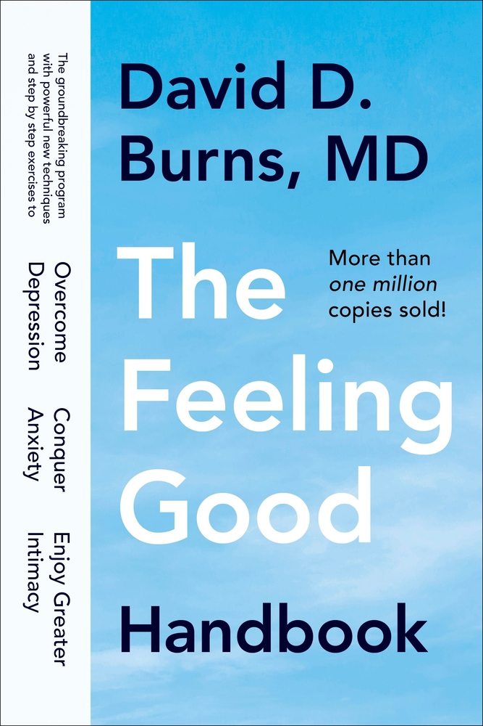
Note
Much of the material in this presentation is adapted from The Feeling Good Handbook (1999) by David Burns, so anything in this presentation that is not attributed to another source is likely borrowed (or shamelessly lifted!) from that text.
So, you can safely attribute the positive aspects of this presentation to Burns, and any mistakes and omissions to me!

Slide 3
Why do I never have any time?
There are “only” 168 hours in a week (24⮾7). How do you spend them?
Demands on our time are real:
  Work
  Relationships
  Caregiving
  Sleep
  Household chores
  Exercise/health-related demands
  Miscellaneous problems (e.g., appliances breaking; flat tires)
Much of that is beyond our control.

Slide 4
What CAN we control?
Our thoughts (or mindset).
Our habits (or practices)
This workshop will address 1 first. Doing so will help us take an effective approach to 2.

Slide 5
Change Our Mindset:
Why do people struggle to get stuff done (i.e., procrastinate)? David Burns offers 10 reasons:
  Putting the cart before the horse
  Holding the wrong mastery model
  Fearing failure
  Being perfectionistic
  Lacking rewards
  Trying to motivate yourself with “shoulds”
  Being passive aggressive
  Being unassertive
  Being sensitive to coercion
  Not wanting to perform the task

Slide 6
1. Putting the cart before the horse
Seemingly silly question: Which comes first, motivation or action?

Slide 7
1. Putting the cart before the horse - 2
Most people think that you have to be motivated in order to take action. That is a mistake.
How it really works:
Action → Motivation → More action.
Goal: If you need to, force yourself to take action. This includes committing to action and scheduling time on the calendar to do it.

Slide 8
2. The Mastery model
Another seemingly silly question: Does being smarter make academic work easier?

Slide 9
2. The Mastery Model - 2
Gauss:
  In the 1780s a provincial German schoolmaster gave his class the tedious assignment of summing the first 100 integers. The teacher's aim was to keep the kids quiet for half an hour, but one young pupil almost immediately produced an answer: 1 + 2 + 3 + ... + 98 + 99 + 100 = 5,050. The smart aleck was Carl Friedrich Gauss, who would go on to join the short list of candidates for greatest mathematician ever. Gauss was not a calculating prodigy who added up all those numbers in his head. He had a deeper insight: If you "fold" the series of numbers in the middle and add them in pairs—1 + 100, 2 + 99, 3 + 98, and so on—all the pairs sum to 101. There are 50 such pairs, and so the grand total is simply 50×101. The more general formula, for a list of consecutive numbers from 1 through n, is n(n + 1)/2. Source.
De Moivre on Newton:
  Took Descartes's Geometry in hand, tho he had been told it would be very difficult, read some ten pages in it, then stopt, began again, went a little farther than the first time, stopt again, went back again to the beginning, read on till by degrees he made himself master of the whole, to that degree that he understood Descartes's Geometry better than he had done Euclid.

Slide 10
2. The Mastery Model - 3
We often wrongly suppose that productive people find work/achievement easy. They don’t face frustration, setbacks, or problems, and they never doubt themselves.
This is completely false. Productive people continue forward in spite of the inevitable challenges, setbacks, and frustrations.
We want to adopt a “coping model”: accept that self-doubt and unanticipated problems are a fact of life. We should expect them and view them as a natural part of the process.

Slide 11
3. Fear of failure
If you base your self esteem on achievements, it might be hard to be productive. If you try and fail, that makes you a “loser.”
We might also worry that other people will judge us as “losers.”
These are examples of the cognitive distortions of “mind reading” and “labeling.”

Slide 12
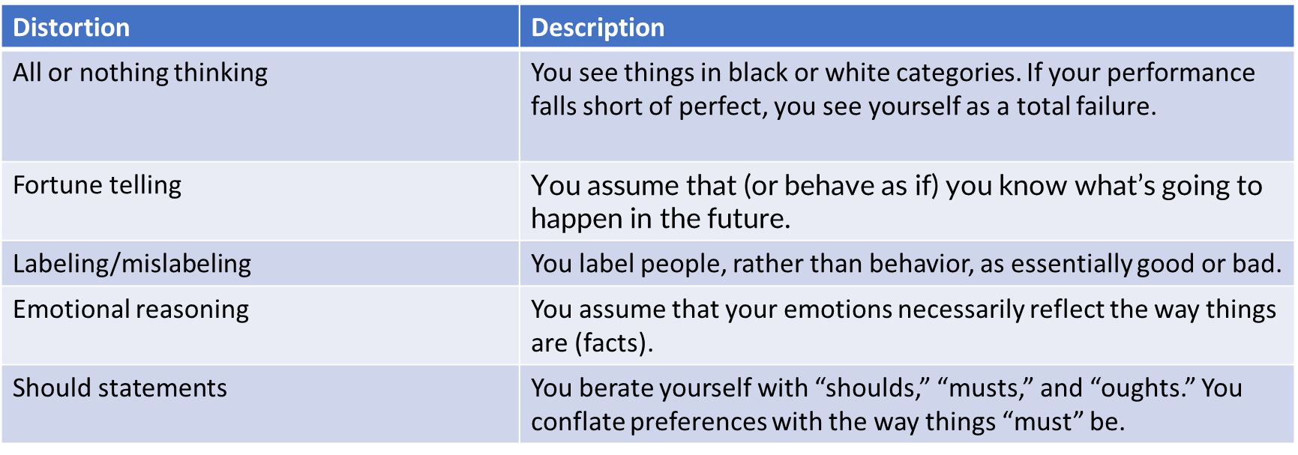
Aside: Cognitive distortions
Reasoning fallacies about ourselves and our emotions. The table below lists some examples (see the handout for more):

Slide 13
3. Fear of failure - 2
Practice: Why are these thoughts distortions?
  If I fail, I am a worthless loser.
  If I fail, people will think I am a worthless loser.
Goal: Recognize that we don’t have to equate our self worth with our achievements. That’s a value choice that comes with pros and cons.

Slide 14
4. Perfectionism
We might convince ourselves that we have to do everything perfectly or that there’s some special reward for being the best.
Practice: What distortions might be involved in this belief? (reference the handout)

Slide 15
4. Perfectionism - 2
Perfectionism | Healthy Pursuit of Excellence
You feel stressed and fear failure | You feel creative and enthusiastic
You are never satisfied with your accomplishments | Your efforts give you joy and satisfaction
You feel the need to impress others to get them to like or respect you | You do not feel that you need accomplishments to be loved or respected
If you make a mistake, you feel like a failure | You see mistakes or failure as a learning opportunity
You think you must always be strong | You are not afraid to be vulnerable or to share your emotions
Perfectionism is not the same thing as the “healthy pursuit of excellence.”
Adapted from Burns, Ten Days to Self-Esteem (1993)

Slide 16
5. Lack of Rewards
We often procrastinate because we don’t give ourselves credit for achievements or downplay what the impact of our actions will be.
Example: I shouldn’t work on that journal article because I have no good ideas. Even if I did publish it, there’d be nothing original or worthwhile in it.
This is the distortion of “discounting the positive.”

Slide 17
5. Lack of Rewards - 2
Productive people give themselves positive affirmations and reward themselves emotionally or materially for making progress and completing tasks.
“Only your thoughts can make you feel good or bad. If you never give yourself credit, you will feel that you can never do anything well enough to satisfy yourself, so it will become pointless to try. Why keep banging your head against a wall?” –David Burns, The Feeling Good Handbook (p. 178)

Slide 18
6. Should statements
What’s wrong with this statement? “I really should study more. If I devoted more time to studying, I’d do better in my courses.”

Slide 19
6. Should statements - 2
The 3 legitimate types of “should”:
  Moral
  Legal
  Law of Nature
Otherwise, what you’re really saying is “I’d prefer it if…” or “It would be to my advantage to…”
One frame creates guilt and inaction. The other helps you evaluate what you want and need.

Slide 20
7. Passive Aggressiveness
We often feel pressure to be nice and to say yes.
This process can create resentment, which causes us to consciously or unconsciously “forget” to do things or do things poorly to “get back at” the person or institution pressuring us.
We even do this to ourselves.
Goal: Develop healthy boundaries and learn to say “no” sometimes.

Slide 21
8. Unassertiveness
Similar to the previous, we agree to do things we don’t want to do (or don’t have the capacity for) because we believe that we have to be nice all the time. We then procrastinate instead of acknowledging our thoughts & feelings.
What distortions might be involved in the belief that we always have to be nice? (refer to the handout)

Slide 22
9. Coercion sensitivity
People pressure you to do things for your own good (e.g., a parent, spouse, supervisor)
Even though they might be right, you dislike their bossy approach, so you procrastinate as a form of rebellion.
Goal: Address the problem (e.g., of bossiness) through communication. If you decide that you still do need to complete the task, frame it as “this is in my interest despite the bossiness.”

Slide 23
10. Lack of desire
You really don’t want to do the task. Maybe part of you knows that it’s not right for you, but you won’t admit that to yourself. Instead, you procrastinate.
Goal: Acknowledge that you really don’t want to complete the task. Figure out whether this lack of desire is justified, and act accordingly (e.g., decide not to do it or force yourself to do it).
Note that procrastination can be healthy.

Slide 24
Change Our Practices: A 5-Step Approach
Preliminary (Step 0): Identify the task(s) we want to complete.
“I procrastinate with everything” is too vague.
Practice: Write down at least 1 specific task you want to complete.

Slide 25
Step 1: Cost-Benefit Analysis
# | Advantage
1.
2.
3.
4.
Should I stop procrastinating and complete the task?
Practice: Make a list of the advantages of procrastinating.

Slide 26
Step 1: Cost-Benefit Analysis -2
Possible advantages:
It’s easy
You can avoid hard work
You can do something else instead
You don’t have to risk failure
It might confer status (e.g., “I’m a special type that doesn’t need to work hard”)
You can get back at people who are nagging you
You can limit people’s ability to put so many demands on you

Slide 27
Step 1: Cost-Benefit Analysis - 3
With all these advantages, why stop procrastinating?
Possibility 1: You shouldn’t. Your procrastination is telling you something important.
Possibility 2: Your procrastination offers more disadvantages than advantages.
Let’s figure it out…

Slide 28
Step 1: Cost-Benefit Analysis - 4
# | Disadvantage
1.
2.
3.
4.
Let’s make a list of disadvantages of procrastinating.
Which is greater—the advantages or disadvantages? You can assign a numerical weight to both if you want…

Slide 29
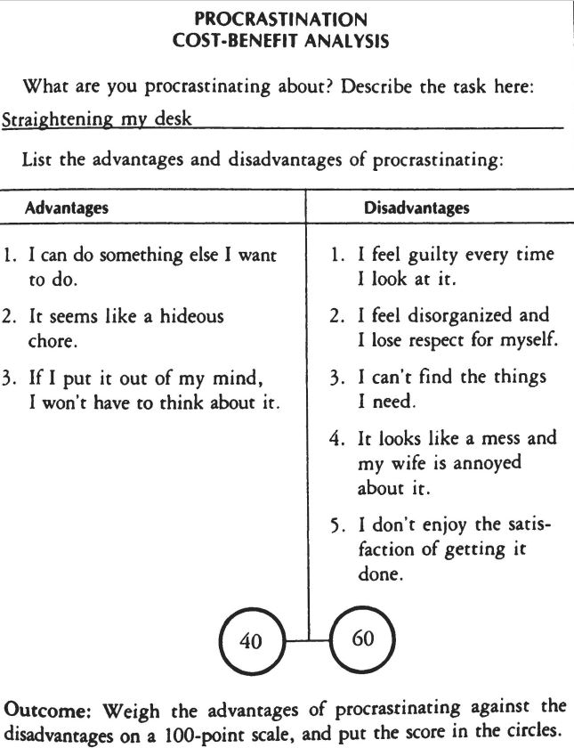

Slide 30
Step 1: Cost-Benefit Analysis - 5
If you want, you can do a similar cost-benefit analysis of getting started on the task today.
After you’ve done this analysis, what does it make sense to do?
Start today?
Schedule a time to get started?
Never complete the task?

Slide 31
Step 2: Make a Plan
Schedule a time to get started. Write down what time today (or what date and time later) you intend to get started on your task.
Now, consider some problems that may arise that will prevent you from completing the task. How will you overcome them?
Problem | Solution

Slide 32
Step 2: Make a Plan - 2
Problem | Solution
1. I won’t feel like it when 3pm rolls around. | I can tell myself I've made a decision to work on the book between 3pm and 4pm whether I feel like it or not.
2. I'll get distracted by other things. I'll decide that I should straighten up my office first. | I can work on it at the library instead of my office. Then I won't feel so tempted by the distractions in my office.
3. A student might want an appointment. | If a student wants an appointment, I can say that I have a commitment from 3pm until 4:00pm.
4. Once I try to write the outline, I'll feel inadequate. | I can decide to jot down some ideas for one hour, whether or not it seems like I have anything worthwhile to say. Then I will give myself credit for that.
Here’s an example from David Burns’s book.

Slide 33
Step 3: Make the Job Easy
Have realistic goals.
If you’re writing a paper, it doesn’t need to be a masterpiece. As Burns says, “why not try to write an ‘adequate’ first sentence instead? That would be far easier, and at least you could get started. Once you have one ‘adequate’ sentence on the paper you can add another and another, until you complete an ‘adequate’ paragraph or a page. Then you can do some ‘adequate’ editing the next day and make this material even better.
Write a “crappy rough draft” a la Anne Lamott

Slide 34
Step 3: Make the Job Easy - 2
Break large tasks into smaller goals by (1) tackling jobs step-by-step, and (2) working in short spurts.
Tackle big jobs step-by-step, for example:
  First step: read the assignment description
  Second step: go to the library and check out some materials (or search on databases)
  Third step: read and skim some of these sources and take notes
  Fourth step: start writing some tentative ideas
  Fifth step: read some more…

Slide 35
Step 3: Make the Job Easy - 3
Work in short spurts. “Life exists one minute at a time, so all you'll ever have to do at any time is one minute's worth of work.”
Start with doing 15 minutes of work (or another amount). If that goes well, you can do more, but anything beyond 15 min is “extra credit.”

Slide 36
Step 4: Think Positively
Identify and squash negative, distorted thoughts that are sapping your energy and crushing your productivity.
Practice: Identify some negative thoughts that sabotage your productivity.

Slide 37
Step 4: Think Positively – 2
Negative Thought or “Task-Interfering Cognition (TIC)” | Distortion | Rational Thought or “Task-Oriented Cognition (TOC)”
I have all these papers to read. | All or nothing thinking | I don’t have to read all of them tonight. But I’d probably feel a lot better if I read at least 1 of them.
I really should start now, but I don’t feel like it. | Should statement; emotional reasoning. | It would be to my advantage to start now.
The TIC-TOC Method

Slide 38
Step 4: Think Positively – 3
Negative Thought or “Task-Interfering Cognition (TIC)” | Distortion | Rational Thought or “Task-Oriented Cognition (TOC)”
Practice

Slide 39
5. Give yourself credit
Give yourself mental (or tangible) rewards for getting work done.
Take a few minutes to make a list of everything you accomplished in the day.
Avoid obsessing over all the things you still have left to do.

