Slide 1
Frequently asked questions about research papers
Omar Hussein
Graduate Writing specialist
The CSULB graduate Center

Slide 2
Preliminaries
These slides borrow and steal shamelessly from several sources, including The craft of research by Booth, Colomb, & Williams and Academic writing for graduate students by Swales & Feak. Throughout the slides, I note the sources (as I’m doing here) but I don’t always use a level of citation appropriate to a research paper.

Slide 3
“IMRD” or “IMRAD”
Academic papers tell a story about research. Stories generally have a beginning, a middle, and an end.
  INTRODUCTION - What you studied, and why it’s important. (Beginning)
    (Lit Review is part of the Intro in this model)
  METHODS - How you studied it. (Middle)
  RESULTS - What you found. (Middle)
  DISCUSSION - Your interpretation of what you found. (End)

Slide 4
Side note: Empirical vs. non-empirical studies
Empirical studies collect and analyze experimental/empirical data. Use some version of IMRD.
Non-empirical studies do not involve experimental/empirical data:
  A literature review study, which summarizes the state of research or knowledge in a field.
  Literary (or textual or artistic or cultural) interpretation, criticism, or analysis.
  Historical analysis (although such research also may involve empirical data collection).
  Comparing and contrasting particular theories, arguing that one theory is better suited to tackling a particular problem than another theory.
  Making reasoned arguments, or proving theorems or other claims, about abstract or “a priori” areas of knowledge like philosophy, logic, some areas of theoretical physics, and some areas of mathematics.

Slide 5
Thinking about the reader
For any piece of writing, you should always be thinking about the reader.
  Who is the reader?
  What does the reader want to know? (i.e., why is the reader reading my paper?)
Don’t think of the reader as your professor (even if your professor is the only person who’s actually going to read the paper). Thinking this way is a mistake.
As Booth, Colomb, and Williams (BCW) put it (regarding introductions to class papers):
    When you draft your introduction, imagine you are writing to someone who has read some of the same sources as you and is generally interested in the same issues, but does not know what specifically happened in your class (p. 237).

Slide 6
Who is the Imaginary reader?
  “Pretend that your reader is lazy, stupid, and mean. He's lazy in that he doesn't want to figure out what your convoluted sentences are supposed to mean, and he doesn't want to figure out what your argument is, if it's not already obvious. He's stupid, so you have to explain everything you say to him in simple, bite-sized pieces. And he's mean, so he's not going to read your paper charitably. (For example, if something you say admits of more than one interpretation, he's going to assume you meant the less plausible thing.) If you understand the material you're writing about, and if you aim your paper at such a reader, you'll probably get an A.” –Jim Pryor

Slide 7
Introduction & Problem Statement

Slide 8
The Common structure of Introductions
To ensure that they are friendly to readers, almost all introductions should have these 3 parts:
  1. A common ground (that establishes a context and background)
  2. A problem (that disrupts the common ground)
  3. A response to the problem (that says what your paper is going to do about this problem)
One way to think of these parts is as follows: (1) “Research has shown…” (2) “However,…” (3) “Therefore, this paper will…”

Slide 9
Example
[Common Ground] Research has shown that public health education campaigns can be highly effective at improving healthy behaviors among the general public. For example, a 2015 study by Harvard University demonstrated that a decades-long campaign of public service announcements has helped reduce the rate of smoking in the general public by as much as 50%. In addition, Johnson et al. (2019) found that social media campaigns about the dangers of e-cigarettes significantly reduced the rates of e-cigarette use among high schoolers. [Problem] However, insufficient scholarly attention has been given to the role that popular culture can play in improving these health education campaigns. Some studies have examined the effectiveness of celebrity spokespeople in increasing a public health campaigns’ broad appeal (e.g., Cosgrove, 2011; Draper, 2017 ). Yet few studies have looked at the role of popular culture more broadly, including the use of popular music and the integration of other popular media (e.g., video games) to increase the reach and effectiveness of these campaigns. [Response] Therefore, this paper examines an innovative new multimedia anti-smoking campaign that targets the younger demographic by incorporating multiple elements of popular culture. The goal is to assess the effectiveness of this campaign and determine what lessons can be learned for improving such campaigns in general.

Slide 10
Side note: Claim, Reason, & Evidence
An argument is A CLAIM which is based on REASONS which in turn are supported by EVIDENCE.
  An example of a simple argument is:
  CLAIM: Food manufacturers should reduce the amount of sugar added to food items.
  REASON: Because overconsumption of sugar is bad for people’s health.
  EVIDENCE: Research has shown that overconsumption of sugar is implicated in chronic health disorders such as obesity and cardiovascular disease (Bleich & Vercammen, 2020; Schmidt, 2014; Yang et al., 2014).

Slide 11
Side note: Claim, Reason, & Evidence – 2
Depending on your topic & audience, the reason might be obvious (and thus unstated).
But the “mean” reader always demands evidence.
So, common grounds and problem statements involve CLAIMS that require EVIDENCE in the form of citations (you can see this point in action on the example slide)

Slide 12
Practice – Identify common ground etc.
(1) The traditional formulation of quantum field theory—encoded in its very name— is built on the two pillars of locality and unitarity… (2) Starting with massless particles of spin-one or higher, we are forced to introduce even larger, gauge redundancies… (3) All of these developments have made it completely clear that there are powerful new mathematical structures underlying the extraordinary properties of scattering amplitudes in gauge theories. (4) If history is any guide, formulating and understanding the physics in a way that makes the symmetries manifest should play a central role in the story. (5) The Grassmannian picture does this, but up to this point there has been little understanding for why this formulation exists, exactly how it works, or where it comes from physically. (6) Our primary goal in this note is to resolve this unsatisfactory state of affairs. (7) We will derive the connection between scattering amplitudes and the Grassmannian, starting physically from first principles…
Source: Arkani-Hamed et al. (2014). https://arxiv.org/pdf/1212.5605.pdf

Slide 13
Practice - Answer
[Common Ground] (1) The traditional formulation of quantum field theory—encoded in its very name— is built on the two pillars of locality and unitarity… (2) Starting with massless particles of spin-one or higher, we are forced to introduce even larger, gauge redundancies… (3) All of these developments have made it completely clear that there are powerful new mathematical structures underlying the extraordinary properties of scattering amplitudes in gauge theories. (4) If history is any guide, formulating and understanding the physics in a way that makes the symmetries manifest should play a central role in the story. [Problem] (5) The Grassmannian picture does this, but up to this point there has been little understanding for why this formulation exists, exactly how it works, or where it comes from physically. [RESPONSE] (6) Our primary goal in this note is to resolve this unsatisfactory state of affairs. (7) We will derive the connection between scattering amplitudes and the Grassmannian, starting physically from first principles…
Source: Arkani-Hamed et al. (2014). https://arxiv.org/pdf/1212.5605.pdf

Slide 14
Research questions
Your “Response” (what you’re going to do about the problem) leads naturally to the research questions.
Good research questions build on discussion already happening in the field. They should be interesting and provide something new or fill in a “gap.”
They should have a limited scope:
  POOR - Why did it rain all day?
  BETTER - What climatological factors in Southern California in early spring 2025 made rain more likely?

Slide 15
Literature Review

Slide 16
What lit reviews do
Lit reviews have 2 main functions:
    To give the reader the background needed to understand your topic or question.
    To point out gaps in knowledge that demonstrate why more study is needed (i.e., why YOU are doing a new study).

Slide 17
In short…
In the words of the insightful “Thesis Whisperer” blog, a good literature review is:
“a simple, but competent run through of the major authors with a thread of an argument running through the whole. The argument should be connected to why you are bothering to do the study.”
The Thesis Whisperer. (2011). 5 ways to fail your PhD [Blog post]. Retrieved from https://thesiswhisperer.com/2011/02/17/5-ways-to-fail-your-phd/

Slide 18
A Lit Review is not a List of studies
Organize the lit review by ideas.
Synthesize/integrate your discussion.
One way to do this is to organize your discussion around a handful of key “themes.”

Slide 19
Example
    Introduction & Problem Statement.
      Common Ground: “Research has shown that students from marginalized groups often face barriers to persistence and retention in their degree programs… Several studies have identified such barriers facing Zombie college students…”
      Problem (that destabilizes the common ground): “However, few studies have examined the experiences of Zombie undergraduates who face such barriers, focusing instead on institutional barriers…”
      Response: “Therefore, this study explores the experiences of Zombie undergraduates at a 4-year public university to understand the barriers they face…”
    Literature Review…
Now, the lit review is going to examine the scholarly research related to achieve the 2 functions mentioned earlier: (1) Give the reader background on what’s already been studied on the topic, (2) point out the things that researchers haven’t figured out, which is why we have the problem above.

Slide 20
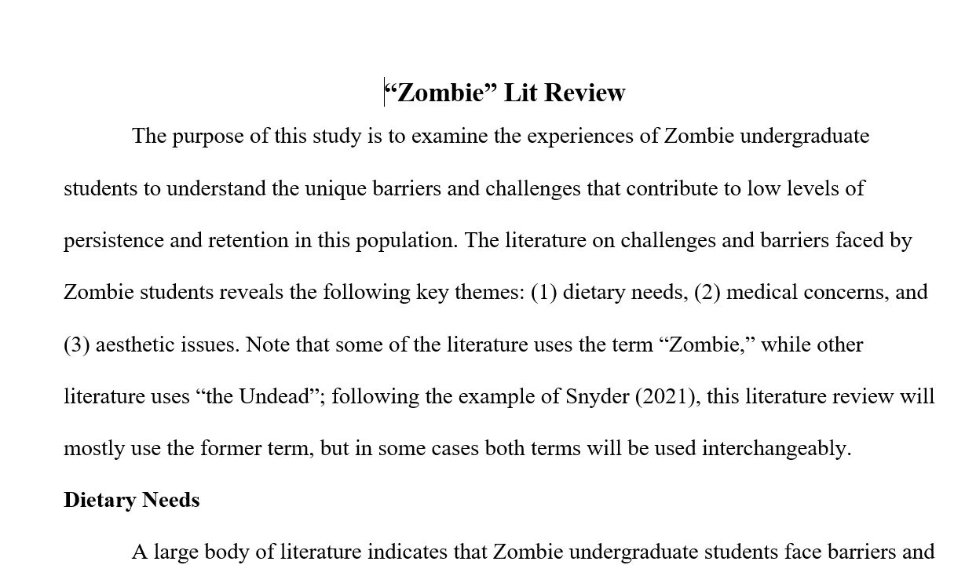
Example - 2

Slide 21
Example - 3
Dietary Needs
A large body of literature indicates that Zombie undergraduate students face barriers and challenges resulting from their highly specific dietary needs (Brooks, 2006; Fulci, 1979; Kirkman & Darabont, 2010; Levine, 2013; Romero, 1968, 1985). It is sometimes stated that Zombies must eat brains to survive (e.g., Jackson, 1992; O’Bannon, 1985), but this claim is based mostly on stereotypes; for example, the pioneering work of George A. Romero (1968, 1978, 1985, 2005, 2007, 2009) has extensively documented the diversity of Zombie diets, which include both live and recently deceased flesh (not restricted to brains). Stereotypes notwithstanding, such highly specific dietary needs present challenges for college campuses attempting to meet the needs of Zombie students (Seok-Jung, 2014). Some studies have found that campuses’ efforts to provide Zombie-appropriate meal choices at cafeterias were stymied by “discriminatory” federal legislation (Fleischer, 2009, 2019; Jarmusch, 2019). Other studies found that campus officials themselves often resisted efforts to make their food offerings more Zombie-friendly, in many cases on the basis of insensitive and politically motivated views (Levine, 2013; Romero, 2009). For example, Romero (2009) and Levine (2013) have studied anti-Zombie racism and its stifling effects on campus efforts to accommodate Zombie students. Taken together, these intersecting issues (highly-specific dietary needs, discriminatory federal legislation, anti-Zombie racism) create serious barriers and challenges for Zombie students, which in turn negatively impact the persistence and retention of these students in degree programs (Fresco, 2017; Sang-Ho, 2016)...
…As noted elsewhere in this study, research has demonstrated that Zombie students have low rates of persistence and retention compared to their non-Zombie peers, a problem that has persisted for decades (Department of Education, 2018; King & Romero, 1982; Snyder, 2004). Recent work has shown that, for specific campuses, these low rates are strongly correlated with the above-mentioned inadequate attention to Zombie dietary needs…
Medical Concerns
Medical concerns represent another key theme that emerges in the literature on barriers facing Zombie undergraduates (Sung-il et al., 2022). Since Zombie tissues are technically

Slide 22
How to pick themes
Problem: We don’t know enough about experiences of Zombie undergrads as they relate to barriers to persistence and retention.
Themes are often
in the intersections →
College Undergrads
Zombies
Barriers to persistence and retention

Slide 23
methods

Slide 24
Methods – who, what, where, when, how, why
Move | Description
Overview | Short summary of research method; near the beginning.
Aims, questions, hypothesis | What the research attempts to find out.
Subjects &/or materials | What people, groups, or objects were studied, how they were selected, & what materials/equipment were used to study them
Location | Where the research took place (and maybe why)
Procedure | The process used to obtain the data.
Limitations | The (potential) shortcomings of the method.
Data analysis | How the data was analyzed.
Source: Peacock (2011), cited by Swales and Feak (2012)

Slide 25
Limitations
Built in limits to what your study method is capable of accomplishing (often related to assumptions)
Example: You asked participants to self-report how much alcohol they drink. But it is possible that some participants might be embarrassed by their excessive drinking habits and under-report. So, for your study to work, you had to make the assumption that the participants are self-reporting accurately, which limits the potential truthfulness (reliability) of what you found.
Can you brainstorm some other possible limitations?

Slide 26
results

Slide 27
What results sections do
Present your findings simply and clearly.
Summarize/organize your data (not a “data dump”)
Report only representative data – not every single datum
Repeat in the text only the most important findings shown in tables and graphs.
Include negative data—what was not found—only if useful for interpreting the results
In the text, cite by name and number every table and figure that appears in the section (e.g. “Figure 4 shows…”)
Include only tables and figures that are necessary, clear, and worth reproducing

Slide 28
discussion

Slide 29
The Discussion section…
…interprets your results against a background of existing knowledge, “putting the Results in conversation with the Lit Review.”
…explains what is new in your work and why it matters.
…discusses both the limitations and the implications of your results and relates observations to other relevant studies (mentioned in your literature review).
…states new hypotheses when warranted, clearly labeled as such.
…includes recommendations, when appropriate.

Slide 30
One way to organize the discussion
Move 1 – Re-state background information (remind the reader of your research purposes, theory, methodology). This is optional, but common in many fields.
Move 2 – Summarize and report key results.
Move 3 – Comment on the key results (make claims, explain the results, compare the new work with previous studies, offer alternative explanations)
Move 4 – State the limitations of the study
Move 5 (Conclusion) – Make recommendations for future implementation and/or future research.

Slide 31
Questions
?

